Slide 1
SOFTWARE DEVELOPMENT BUSINESS PLAN INFOGRAPHICS
Here is where this template begins

Slide 2
ABOUT SOFTWARE DEVELOPMENT BUSINESS PLAN
This template contains an assortment of complementary infographic resources for the Software Development Business Plan presentation.
These infographics are adapted to the style of the aforementioned presentation, so you can insert them easily and have them completely integrated at once. You just need to do the following:
Select the element that you want to copy
Right-click and choose “Copy”
Go to the slide where you want the element to appear
Right-click and choose “Paste”

Slide 3
SOFTWARE DEVELOPMENT BUSINESS PLAN
01
03
MERCURY
MARS
Mercury is the closest planet to the Sun
Despite being red, Mars is a cold place
02
04
SATURN
JUPITER
It is composed of hydrogen and helium
It’s the biggest planet in the Solar System

Slide 4
SOFTWARE DEVELOPMENT BUSINESS PLAN
PLANS | BASIC | STANDARD | PRO
MERCURY
VENUS
MARS
JUPITER
$/YEAR | $50 | $100 | $300

Slide 5
SOFTWARE DEVELOPMENT BUSINESS PLAN
MERCURY
JUPITER
Mercury is the closest planet to the Sun
It’s the biggest planet in the Solar System
VENUS
SATURN
Venus is the second planet from the Sun
Saturn is a gas giant and has several rings
MARS
NEPTUNE
Despite being red, Mars is a cold place
Neptune is far away from Earth

Slide 6
SOFTWARE DEVELOPMENT BUSINESS PLAN
TEAM | PHASE | JAN | FEB | MAR | APR | MAY | JUN | JUL | AUG
TEAM A | Mercury is the closest planet to the Sun
TEAM B | Jupiter is the biggest planet of them all
TEAM C | Despite being red, Mars is actually a very cold place

Slide 7
SOFTWARE DEVELOPMENT BUSINESS PLAN
40%
80%
MERCURY
MARS
Mercury is the closest planet to the Sun
Despite being red, Mars is a cold place
60%
25%
SATURN
JUPITER
It is composed of hydrogen and helium
It’s the biggest planet in the Solar System

Slide 8
SOFTWARE DEVELOPMENT BUSINESS PLAN
MERCURY
JUPITER
Mercury is the closest planet to the Sun
It’s the biggest planet in the Solar System
VENUS
SATURN
Venus is the second planet from the Sun
Saturn is a gas giant and has several rings

Slide 9
SOFTWARE DEVELOPMENT BUSINESS PLAN
MERCURY
Earth is the third planet from the Sun
MOBILE
Mercury is the closest planet to the Sun
Mars is actually a very cold place
The Moon is Earth’s only natural satellite
VENUS
Venus is the second planet from the Sun
DESKTOP
The Sun is the star that we orbit around
Neptune is far away from Earth
JUPITER
Jupiter is the biggest planet of them all
Saturn was named after a Roman god

Slide 10
SOFTWARE DEVELOPMENT BUSINESS PLAN
PHASE | TASK DESCRIPTION | CHECK
MERCURY | Mercury is the closest planet to the Sun | Yes
 | It is the smallest planet of them all | No
VENUS | Venus is the second planet from the Sun | No
 | It is extremely hot, even hotter than Mercury | Yes
JUPITER | Jupiter doesn’t have a solid surface | Yes
 | It was named after the Roman god of the skies | No
SATURN | Saturn is the ringed planet | Yes

Slide 11
SOFTWARE DEVELOPMENT BUSINESS PLAN
MERCURY
01
Mercury is the closest planet to the Sun
25%
VENUS
02
Venus is the second planet from the Sun
40%
EARTH
03
Earth is the third planet from the Sun
15%
MARS
04
Despite being red, Mars is very cold
20%

Slide 12
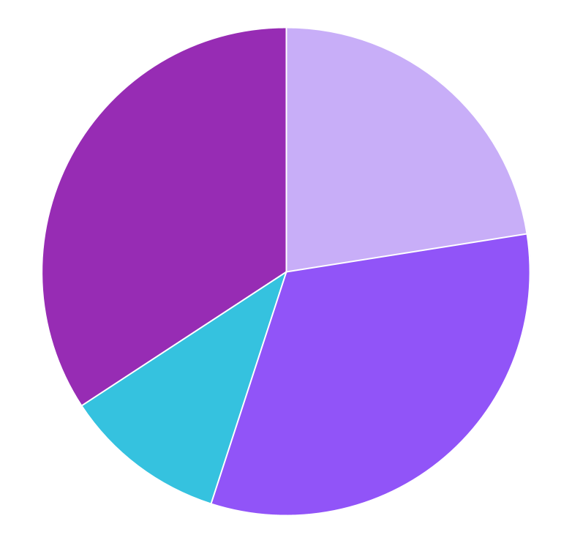
SOFTWARE DEVELOPMENT BUSINESS PLAN
22%
32%
TEAM 1
TEAM 2
Mercury is the closest planet to the Sun
Despite being red, Mars is a cold place
12%
34%
TEAM 3
TEAM 4
Saturn is a gas giant and has rings
Jupiter is the biggest planet of them all
Follow the link in the graph to modify its data and then paste the new one here. For more info, click here

Slide 13
SOFTWARE DEVELOPMENT BUSINESS PLAN
MERCURY
JUPITER
SATURN
Mercury is the closest planet to the Sun
It’s the biggest planet in the Solar System
It is composed of hydrogen and helium
35%
25%
40%

Slide 14
SOFTWARE DEVELOPMENT BUSINESS PLAN
 | WEEK 1 |  |  | WEEK 2 |  |  | WEEK 4 |  |  | WEEK 4
Mercury is very small
Venus is a hot planet
Earth has life
Mars is made of basalt
TEAM A | Neptune is the farthest planet from the Sun
TEAM B | Saturn is a gas giant and has several beautiful rings

Slide 15
SOFTWARE DEVELOPMENT BUSINESS PLAN
STEP 1
Mercury is the closest planet to the Sun
STEP 2
Venus is the second planet from the Sun
STEP 3
Earth is the planet on which we all live
STEP 4
Despite being red, Mars is very cold

Slide 16
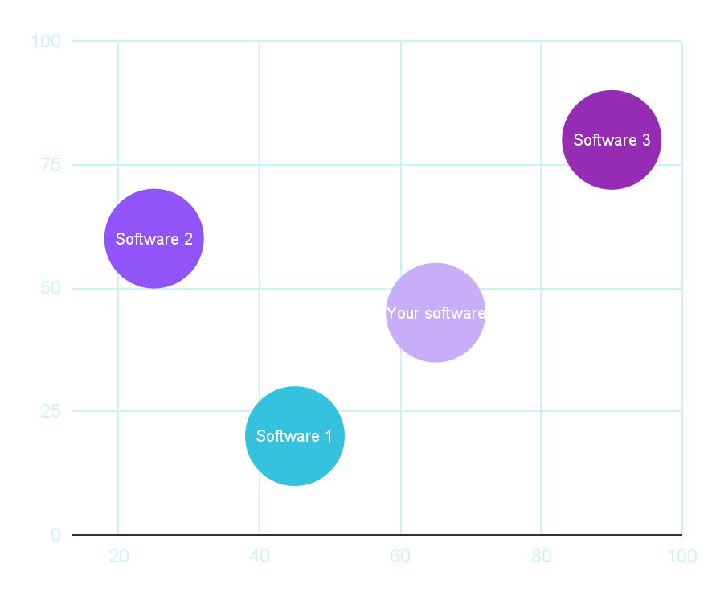
SOFTWARE DEVELOPMENT BUSINESS PLAN
YOUR SOFTWARE
SOFTWARE 1
Mercury is the closest planet to the Sun
Despite being red, Mars is a cold place
SOFTWARE 2
SOFTWARE 3
Saturn is a gas giant and has rings
Jupiter is the biggest planet of them all
CONCLUSION
Venus has a beautiful name, but also high temperatures
Follow the link in the graph to modify its data and then paste the new one here. For more info, click here

Slide 17
SOFTWARE DEVELOPMENT BUSINESS PLAN
MANAGING DIRECTOR
TEAM A
TEAM B
TEAM C
TEAM D
MERCURY
NEPTUNE
VENUS
JUPITER
EARTH
SATURN
MARS
Mercury is the closest planet to the Sun
Venus is the second planet from the Sun
Earth is the third planet from the Sun
Despite being red, Mars is very cold

Slide 18
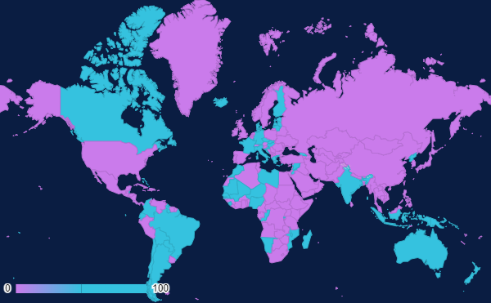
SOFTWARE DEVELOPMENT BUSINESS PLAN
75%
MOBILE
Mercury is the closest planet to the Sun
25%
DESKTOP
Saturn is a gas giant and has rings
Follow the link in the graph to modify its data and then paste the new one here. For more info, click here

Slide 19
SOFTWARE DEVELOPMENT BUSINESS PLAN
PAINS
GAINS
MERCURY
50%
MARS
30%
VENUS
80%
SATURN
45%
MICHAEL DOE
JUPITER
65%
EARTH
75%
PROFILE
AGE | 25-35
STUDIES | Graduate
STATUS | Single
DEMOGRAPHICS
LOCATION | UK
OCCUPATION | Sales
INCOME | $30.000
INTERESTS
Mars is a cold planet
Jupiter is a big planet
Saturn is a gas giant

Slide 20
SOFTWARE DEVELOPMENT BUSINESS PLAN
Yes
Neptune is far away from us
Earth is the planet with life
Yes
No
No
Yes
UX TEST
Mercury is very small
Jupiter is a gas giant
Mars is full of iron oxide dust
No
Saturn has beautiful rings

Slide 21
SOFTWARE DEVELOPMENT BUSINESS PLAN
50K
MERCURY
Mercury is the closest planet to the Sun
VENUS
20K
Venus is the second planet from the Sun
EARTH
5K
Earth is the third planet from the Sun

Slide 22
SOFTWARE DEVELOPMENT BUSINESS PLAN
PHASE 1
TASK 1 | Yes
TASK 2 | No
TASK 3 | Yes
TASK 4 | No
TEAM A
PHASE 2
TASK 1 | No
TASK 2 | No
TASK 3 | Yes
TASK 4 | Yes
TEAM B
PHASE 3
TASK 1 | Yes
TASK 2 | Yes
TASK 3 | Yes
TASK 4 | No
TEAM C

Slide 23
SOFTWARE DEVELOPMENT BUSINESS PLAN
Mercury is the closest planet to the Sun
CLASSIC
MODERN
Venus is the second planet from the Sun
STATIC
DINAMIC
Earth is the third planet from the Sun
BASIC
COMPLEX
Despite being red, Mars is very cold
FREE
PAYMENT

Slide 24
SOFTWARE DEVELOPMENT BUSINESS PLAN
STEP 1
STEP 2
STEP 3
Mercury is the closest planet to the Sun
Venus is the second planet from the Sun
Earth is the third planet from the Sun
STEP 4
STEP 5
STEP 6
Saturn was named after a Roman god
Jupiter is the biggest planet of them all
Despite being red, Mars is very cold

Slide 25
SOFTWARE DEVELOPMENT BUSINESS PLAN
TO DO | DOING | DONE
Mercury is very small | Mars is very cold | Saturn was named after a Roman god
Venus is the second planet from the Sun | Jupiter doesn’t have a solid surface
Earth is the planet on which we all live |  | Neptune is the fourth-largest planet in the Solar System
Research
Design
Development

Slide 26
SOFTWARE DEVELOPMENT BUSINESS PLAN
FUNCTION 1
3/5
FUNCTION 2
1/5
Venus has a beautiful name and is the second planet from the Sun
FUNCTION 3
4/5
FUNCTION 4
5/5
Earth is the third planet from the Sun and the only one that harbors life
FUNCTION 5
2/5

Slide 27
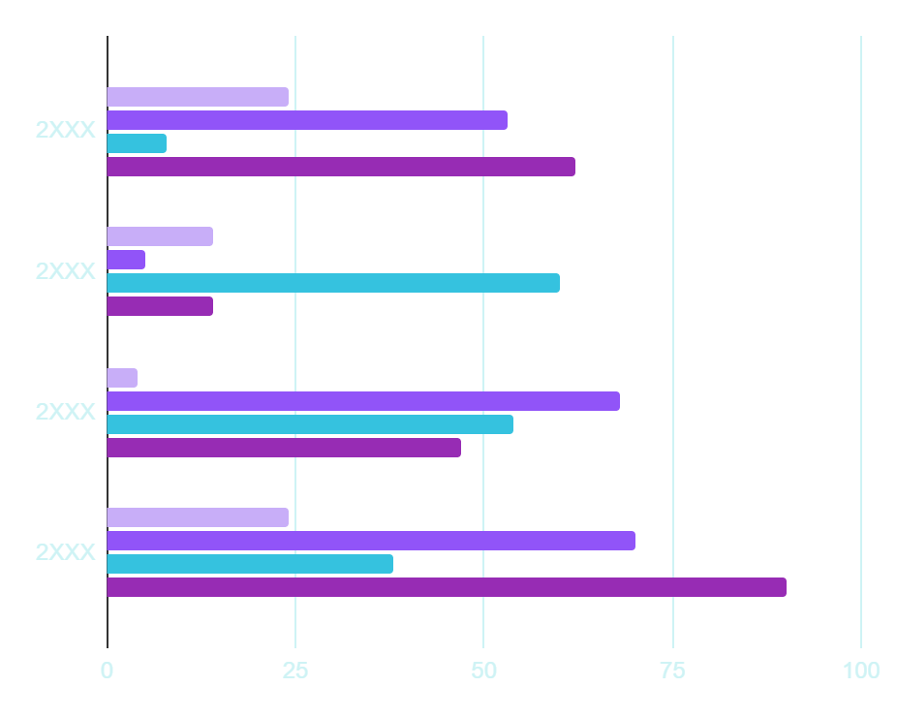
SOFTWARE DEVELOPMENT BUSINESS PLAN
+0%
TEAM 1
Mercury is the closest planet to the Sun
+17%
TEAM 2
Venus is the second planet from the Sun
+30%
TEAM 3
Earth is the third planet from the Sun
+28%
TEAM 4
Despite being red, Mars is very cold
Follow the link in the graph to modify its data and then paste the new one here. For more info, click here

Slide 28
SOFTWARE DEVELOPMENT BUSINESS PLAN
SATURN
EARTH
Saturn is a gas giant and has several rings
Earth is the third planet from the Sun
MARS
NEPTUNE
Despite being red, Mars is very cold
Neptune is far away from Earth

Slide 29
SOFTWARE DEVELOPMENT BUSINESS PLAN
Venus is the second planet from the Sun
Saturn is a gas giant and has rings
VENUS
SATURN
20%
45%
80%
60%
MERCURY
JUPITER
Mercury is the closest planet to the Sun
Jupiter is the biggest planet of them all

Slide 30
SOFTWARE DEVELOPMENT BUSINESS PLAN
HOME
CATEGORY 1
CATEGORY 2
CATEGORY 3
CATEGORY 4
MERCURY
VENUS
MARS
JUPITER
Function 1
Function 2
Function 3
Function 4
Function 5
Function 1
Function 2
Function 3
Function 4
Function 5
Function 1
Function 2
Function 3
Function 4
Function 5
Function 1
Function 2
Function 3
Function 4
Function 5

Slide 31
SOFTWARE DEVELOPMENT BUSINESS PLAN
FUNCTIONS | YOUR SOFTWARE | SOFTWARE REFERENCE 1 | SOFTWARE REFERENCE 2
MERCURY IS A SMALL PLANET
VENUS IS A HOT PLANET
WE ALL LIVE ON EARTH
MARS IS A COLD PLANET
JUPITER IS A HUGE GAS GIANT

Slide 32
SOFTWARE DEVELOPMENT BUSINESS PLAN
DON'TS
DO’S
TIPS
Mercury is the closest planet to the Sun
Jupiter doesn’t have a solid surface
Mars is full of iron oxide dust
Despite being red, Mars is very cold
Earth is the third planet from the Sun
Venus is the second planet from the Sun
Saturn is a gas giant and has several rings
Neptune is very far away from the Sun
The Moon is Earth’s natural satellite

Slide 33
Instructions for use
If you have a free account, in order to use this template, you must credit Slidesgo in your final presentation. Please refer to the next slide to read the instructions for premium users.
As a Free user, you are allowed to:
- Modify this template.
- Use it for both personal and commercial projects.
You are not allowed to:
- Sublicense, sell or rent any of Slidesgo Content (or a modified version of Slidesgo Content).
- Distribute Slidesgo Content unless it has been expressly authorized by Slidesgo.
- Include Slidesgo Content in an online or offline database or file.
- Offer Slidesgo templates (or modified versions of Slidesgo templates) for download.
- Acquire the copyright of Slidesgo Content.
For more information about editing slides, please read our FAQs or visit our blog:
https://slidesgo.com/faqs and https://slidesgo.com/slidesgo-school

Slide 34
Instructions for use (premium users)
As a Premium user, you can use this template without attributing Slidesgo.
You are allowed to:
Modify this template.
Use it for both personal and commercial purposes.
Share this template in an editable format with people who are not part of your team.
You are not allowed to:
Sublicense, sell or rent this Slidesgo Template (or a modified version of this Slidesgo Template).
Distribute this Slidesgo Template (or a modified version of this Slidesgo Template) or include it in a database or in any other product or service that offers downloadable images, icons or presentations that may be subject to distribution or resale.
Use any of the elements that are part of this Slidesgo Template in an isolated and separated way from this Template.
Register any of the elements that are part of this template as a trademark or logo, or register it as a work in an intellectual property registry or similar.
For more information about editing slides, please read our FAQs or visit our blog:
https://slidesgo.com/faqs and https://slidesgo.com/slidesgo-school

Slide 35
Infographics
You can add and edit some infographics to your presentation to present your data in a visual way.
Choose your favourite infographic and insert it in your presentation using Ctrl C + Ctrl V or Cmd C + Cmd V in Mac.
Select one of the parts and ungroup it by right-clicking and choosing “Ungroup”.
Change the color by clicking on the paint bucket.
Then resize the element by clicking and dragging one of the square-shaped points of its bounding box (the cursor should look like a double-headed arrow). Remember to hold Shift while dragging to keep the proportions.
Group the elements again by selecting them, right-clicking and choosing “Group”.
Repeat the steps above with the other parts and when you’re done editing, copy the end result and paste it into your presentation.
Remember to choose the “Keep source formatting” option so that it keeps the design. For more info, please visit our blog.

